Slide 1
Estimation of Hemoglobin Sahli method

Slide 2
Principle
The Hb present in a measured amount of blood is converted by dilute hydrochloric acid into acid hematin, which in dilution is golden brown in color.
The intensity of color depends on the concentration of acid hematin which, in turn, depends on the concentration of Hb.

Slide 3
Principle
The color of the solution, after dilution with water, is matched against golden brown tinted glass rods by direct vision.
The readings are obtained in g%.

Slide 4
Normal values
The average levels and their ranges are as follows:
Males: (13.5–18) g/dl, (14.5 g/dl).
Females: (11.5–16) g/dl, (12.5 g/dl).

Slide 5
Increased Hb
Experimental error
Blood taken more than 20 µl or blood sticking to the outside of the pipette tip.
Fading of colored glass standards (rods).

Slide 6
Increased Hb
High red cell count
Physiological: newborns, high altitude, etc.
Pathological: polycythemia/hypoxia due to heart or lung diseases.

Slide 7
Decreased Hb
Experimental error
Blood sample diluted with tissue fluid.
Blood taken is less than 20 µl.
Color of acid hematin not allowed to develop fully.

Slide 8
Decreased Hb
Decreased red cell count
Physiological: females during pregnancy (hemodilution).
Pathological: all cases of anemia.

Slide 9
Apparatus and materials
Sahli Hemoglobinometer (Hemometer).
Decinormal hydrochloric acid solution (0.1 N HCl).
Materials for skin prick.
Sterile lancet/needle
Sterile gauze and cotton swabs
Methylated spirit/70% alcohol

Slide 10
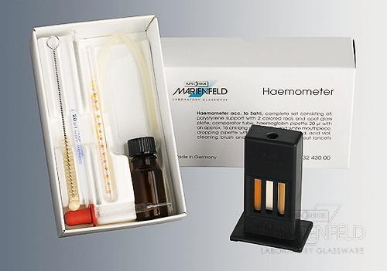

Slide 11
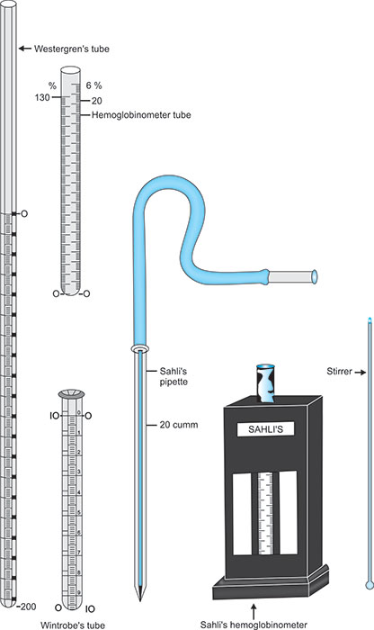

Slide 13
Sahli Hemoglobinometer
Comparator
It is a rectangular plastic box with a slot in the middle which accommodates the calibrated Hb tube.
Non-fading, standardized, golden-brown glass rods are fitted on each side of the slot for matching the color.
An opaque white glass is fitted behind the slot to provide uniform illumination during direct visual color matching.

Slide 14
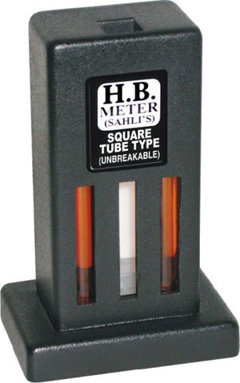

Slide 15
Sahli Hemoglobinometer
Hemoglobin tube
The square or round glass tube is calibrated in g Hb % (2–22 g%) on one side, and in percentage Hb (10–140 %) on the other side.

Slide 16
Sahli Hemoglobinometer
Hemoglobin pipette
It is a glass capillary pipette with only a single calibration mark 0.02 ml (20 µl ).
There is no bulb in this pipette (as compared to cell pipettes) as no dilution of blood is done.

Slide 17
%
gm%
22
140
130
20
120
18
110
16
100
14
90
80
12
20 cmm
20 µl
70
10
60
8
50
40
6
30
4
20
2
Hemoglobin tube
10
Hemoglobin pipette

Slide 18
Sahli Hemoglobinometer
Stirrer
It is a thin glass rod with a flattened end which is used for stirring and mixing the blood and dilute acid.
Pasteur pipette
It is a 8–10 inch glass tube drawn to a long thin nozzle, and has a rubber teat.

Slide 19
Procedure
Using a glass dropper, place 8–10 drops of N/10 HCl in the Hb tube, or up to the mark 20%.

Slide 20
0%

Slide 21
Procedure
Get a finger prick under aseptic conditions, wipe away the first 2 drops of blood.
When a large drop of free-flowing blood has formed again, draw blood up to the 20 µl mark (0.02 ml).
Carefully wipe the blood sticking to the tip of the pipette with a cotton swab.

Slide 23
Procedure
Without any waiting, immerse the tip of the pipette to the bottom of the acid solution and expel the blood gently.
Rinse the pipette 3–4 times by drawing up and blowing out the clear upper part of the acid solution till all the blood has been washed out from it.
Avoid frothing of the mixture. Note the time.

Slide 25
Procedure
Withdraw the pipette from the tube, touching it to the side of the tube, thus ensuring that no mixture is carried out of the tube.
Mix the blood with the acid solution with the flat end of the stirrer by rotating and gently moving it up and down.

Slide 26
Procedure
Put the Hb tube back in the comparator and let it stand for 6–8 minutes.
During this time, the acid ruptures the red cells, releasing their Hb into the solution (hemolysis).
The acid acts on the Hb and converts it into acid hematin which is deep golden brown in color.
The color of acid hematin does not develop fully immediately, but its intensity increases with time.

Slide 27
Procedure
Diluting and matching the color
Dilute the acid hematin solution with distilled water till its color matches the color of the standard tinted glass rods in the comparator.

Slide 29
Procedure
Take the Hb tube out of the comparator and add distilled water drop by drop, stirring the mixture each time and comparing the color with the standard.
Hold the comparator at eye level, against bright but diffused light. Read the lower meniscus (lower meniscus is read in colored transparent solutions).
Notes:
Add D.W to 50% (8 gm) in normal indivisual

Slide 32
Sources of error
Technical error
Due to; not taking exactly 20 µl blood, or not giving enough time for formation of acid hematin, or using an old comparator that has faded glass rods.
Personal error
Since it is a visual method, color matching may vary from person to person.

Slide 33
Observations and results
Compare your color matching with that of your work partner and record the observations in your workbook.
Take the average of 3 readings, and report your result as:
Hb = ……….g/dl.
Notes:
g/dl no need for mentioning the method
% mentioning the method due to % with g/dl differ in different method (sahli, haldin)

Slide 34
Observations and results
1st reading, when the color is slightly darker than the standard:……….g/dl.
2nd reading, when, after adding a few drops of distilled water, the color exactly matches the standard: …………g/dl.
3rd reading, when, after adding some more drops, the color becomes a little lighter than the standard:…………g/dl.

Slide 35
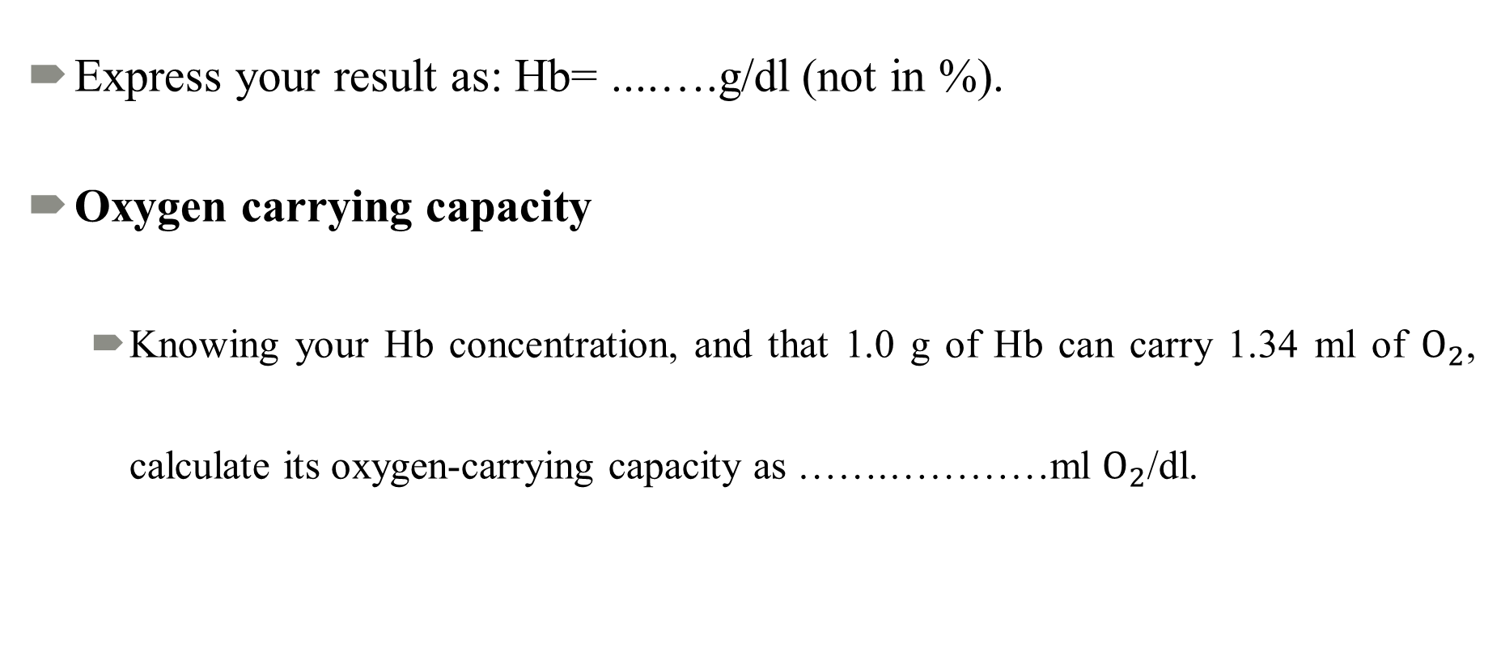
Report
Express your result as: Hb= ....….g/dl (not in %).
Oxygen carrying capacity
Knowing your Hb concentration, and that 1.0 g of Hb can carry 1.34 ml of $O_{2}$, calculate its oxygen-carrying capacity as …….…………ml $O_{2}$/dl.
Notes:
Which mean 100% saturation

Slide 36
Advantages of Sahli method
Simple, fairly quick, and accurate.
It does not require any costly apparatus, since it needs only direct color matching.
Its running cost is minimal and can, therefore, be used in mass surveys.

Slide 37
Disadvantages of Sahli method
Since the acid hematin is not in true solution, some turbidity may occur.
The method estimates only the oxyHb and reduced Hb, other forms, such as carboxyHb and metHb are not estimated.
The degree of error may be high if proper precautions are not taken.
Notes:
Reduced Hb غير متحد مع الهيموغلوبين
metHb=Methma haemoglobin= oxidized haemoglobin (بسبب مواد موكسده
carboxyHb= co )تسمم اول اوكسيد الكاربون

Slide 38
PRECAUTIONS
All precautions mentioned for collecting finger prick blood, and filling the pipette must be observed.
The finger should not be squeezed, and there should not be any blood sticking to the outside of the pipette tip.

Slide 39
PRECAUTIONS
Only the recommended time should be allowed for the formation of acid hematin by the action of acid on Hb.
When diluting the color of acid hematin solution, avoid over-dilution because the color cannot be concentrated.

Slide 40
PRECAUTIONS
When matching the color, the solution should be uniformly golden brown throughout the solution. Dark color near the bottom of the tube indicates poor mixing.
During color matching, 3 readings should be taken to reduce the personal error.

